Slide 1
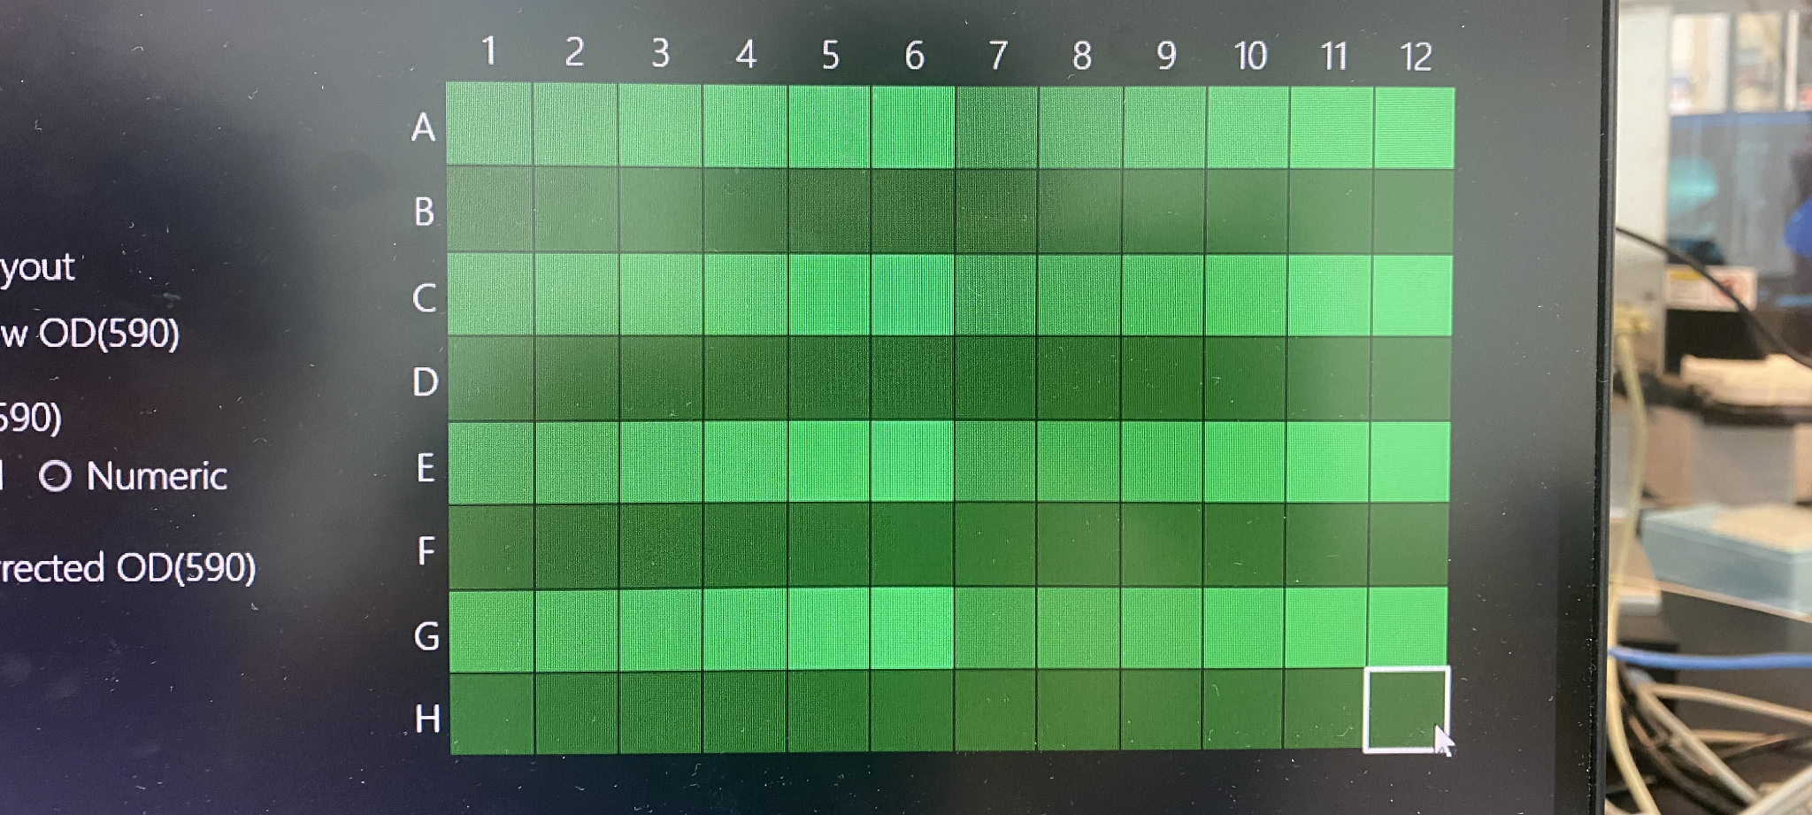
7/12/2023 Updates:
Ran first cells test!
Fixed positioning on Hudson Solo index
Ran 6 well plate on experiment setup with updated Excel structure
Developed full architecture for multiple well Plates and placeholder AI structure
Future Goals:
Use developed code architecture to write a growth assay that starts with human input (4 plates) and then trains AI model to run 8 more plates
Smooth out some PlateCrane movements within structure and upload to Globus
Complete SULI deliverables - poster, paper, etc.
Talk with Ramanathan group to see what elements I can add to the structure to help transitioning their AI software
Run multi-plate cell run next week
Final Form of Project: Showcasing BIO workcell setup with human/AI combination of Multiple Growth Cells
Alp Demirtas

